Slide 1
ANNOTATION: How to have a conversation with the text.

Slide 2
Why annotate?
Marking a passage as you read helps you become an ACTIVE reader – it keeps you AWAKE. It helps you REMEMBER the conversation you had with the text.
It also helps you study, it helps you think of questions to ask in class, and it helps you UNDERSTAND what you are reading.

Slide 3
What does “annotate” mean?
Annotation is a method of writing down your ideas of a text:
To trace your reading
(setting purpose, asking questions, connecting, summarizing, inferring)
To develop your understanding of literary/ historical analysis
(plot, figurative, thematic, events, places)

Slide 4
Good annotations will have a balance of written ideas of
Your own thoughts, connections and ideas
With
Your understanding of the author’s ideas and intentions

Slide 5
So…What does annotation look like?

Slide 6
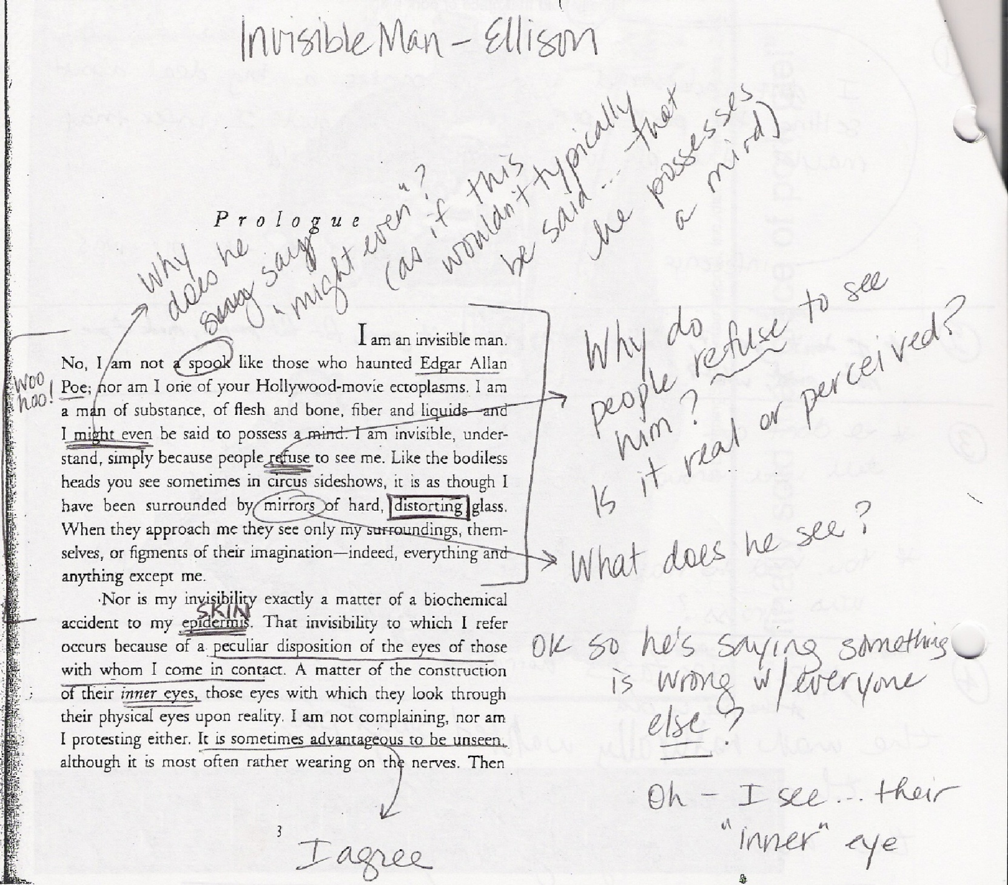

Slide 7
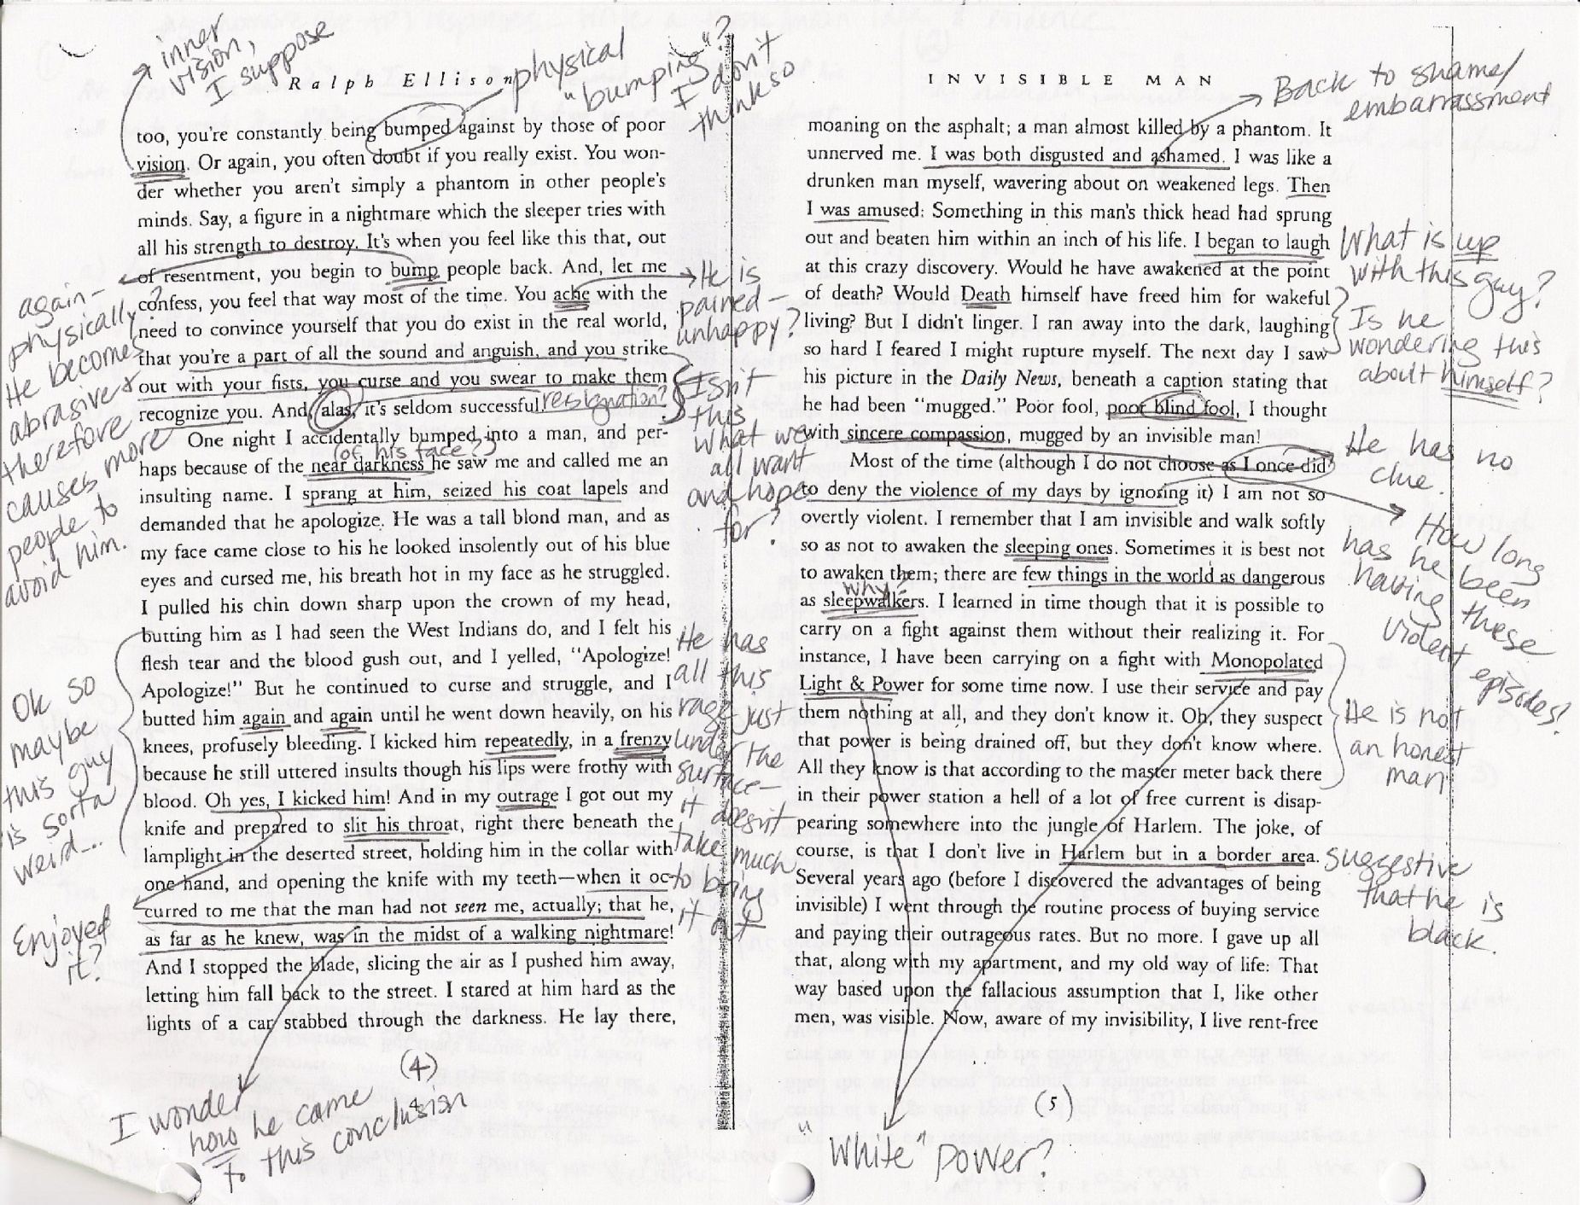

Slide 8
How Do I Annotate? What do I write?

Slide 9
Some ideas & suggestions:
Question marks, exclamation points, smilies, other emoticons
Underline or highlight key words/phrases, draw arrows
Summarize in margins
Bracket important selections
Cross-reference to other parts of text
Comments – agree or disagree
Personal connections
Random associations
(this reminds me of)
Circle/underline figurative devices
Underline dates and important people and places

