Slide 1
Argumentative Essay
Death Penalty

Slide 2
What is an Argumentative Essay?
To write an effective argument, you must support claims with sufficient textual evidence that is reasonable and relevant.
A logical argument convinces the audience because of actual evidence and proof, rather than either the how the writing makes the audience feel, or the character or credentials of the writer.

Slide 3
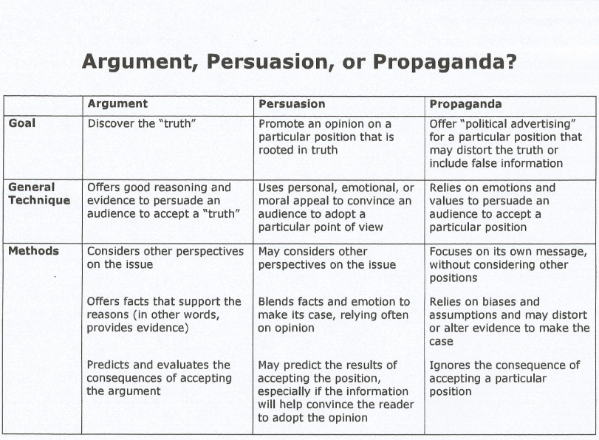

Slide 4
3 purposes of an argument:
To change the reader’s point of view
To bring about some action on the reader’s part
To ask the reader to accept the writer’s explanation or evaluation of a concept, issue or problem using reason and logic to demonstrate the validity of the writer’s claim.

Slide 5
Parts of the Essay
A clear, concise, and defined thesis statement that occurs in the first paragraph of the essay.
Clear and logical transitions between the introduction, body, and conclusion.
Body paragraphs that include evidential support, and bring up opposing viewpoints.
Evidential support (whether factual, logical, or statistical). From the TEXT.
A conclusion that does not simply restate the thesis, but readdresses it in light of the evidence provided.

Slide 6
Introduction
Start with a broad statement about your topic
Give Some General Information
Thesis Statement/ Three main points

Slide 7
What is a thesis statement?
A thesis statement is a strong statement that you can prove with evidence.
It is not a simple statement of fact.
Your thesis statement will be the main idea of your entire project.
A thesis statement should be the product of your own critical thinking after you have done some research.

Slide 8
Body Paragraphs
Begin with your topic sentence for this paragraph.
Give evidence in the form of a quote from a source.
Explain your evidence to the reader.
Transition to your next paragraph.

Slide 9
Counterclaim
A counterclaim is where the writer acknowledges the opposing viewpoints.

Slide 10
Refutation
A Sentence that refutes the counterclaim you just gave.

Slide 11
Conclusion
Begin with a restatement of your thesis
Restate your main points (topic sentences) In a NEW WAY.
End with a broad sentence about your topic.

Slide 12
Arguments for the Death Penalty
Capital punishment is the right punishment for those who take away life- murderers.
Those who have taken a life should be killed.
A life for a life.

Slide 13
Arguments for the Death Penalty
By putting murderers to death you can save future lives.
One thing is certain: no executed person will ever kill again.
A deterrent to those who might commit a crime.
The fear of being executed must surely put off the criminals from committing murder if they know they’ll face the death penalty if caught.

Slide 14
Arguments for the Death Penalty
The families of those killed need justice and retribution (revenge).
Once a criminal is put to death the family can finally feel free of the murderer who killed their loved one.
The safety and relief a family gets when the criminal is put to death is far better than life in prison.

Slide 15
Arguments for the Death Penalty
It is more humane to put someone to death than to keep them locked up for years.
Criminals who’s crimes are considered to be of low danger are having their sentences shortened to deal with jail overcrowding.
It would surely cost a lot more money to keep murderers in prison serving a life sentence than it would to execute them..

Slide 16
Arguments Against the Death Penalty
Cost of Putting someone to death.
Death penalty is 2.5 times more costly than to put someone in prison for life.
The extra cost of putting someone to death gives the option of just putting someone in prison without the possibility of parole.

Slide 17
Arguments Against the Death Penalty
The chance of putting someone to death who is falsely accused.
The chance of someone incorrectly accused being put to death outweighs putting the right criminal to death.
Since 1973, one hundred thirty people have been released form death row due to evidence that shows their wrongful conviction.

Slide 18
Arguments Against the Death Penalty
The publicity of a crime and the long trials that come with it cause more crimes.
Life in prison is more of a deterrent than the death penalty.
Death of a murderer does not bring back a murdered loved one.

Slide 19
Arguments Against the Death Penalty
Capital punishment does not deter crime.
The death penalty is discriminatory and is often used disproportionately against people from poor backgrounds or of particular races, or those with mental health problems.

Slide 20
Checklist
Double Spaced |  | Introduction -lead/hook -summary of issue -thesis statement
12 Point Font |  | 3 Body Paragraphs for Claim -Topic Sentences -1 fact/quote per paragraph -Explanation of facts/quotes in own words -Transition sentence to next paragraph
Times New Roman |  | Counterclaim -Topic Sentence -Refutation -Fact/quote

Slide 21
Checklist
Heading Correct (Student name, teacher name, class, date) |  | Conclusion -Restate Thesis -2-3 sentences restating main points -Solution to problem/Prediction
Title Centered and doesn’t say ‘title’ |  | Grammar & Mechanics
Works Cited Page |  | -At least 3 sources - MLA format - ABC Order

Slide 22
Rubric

