Slide 1
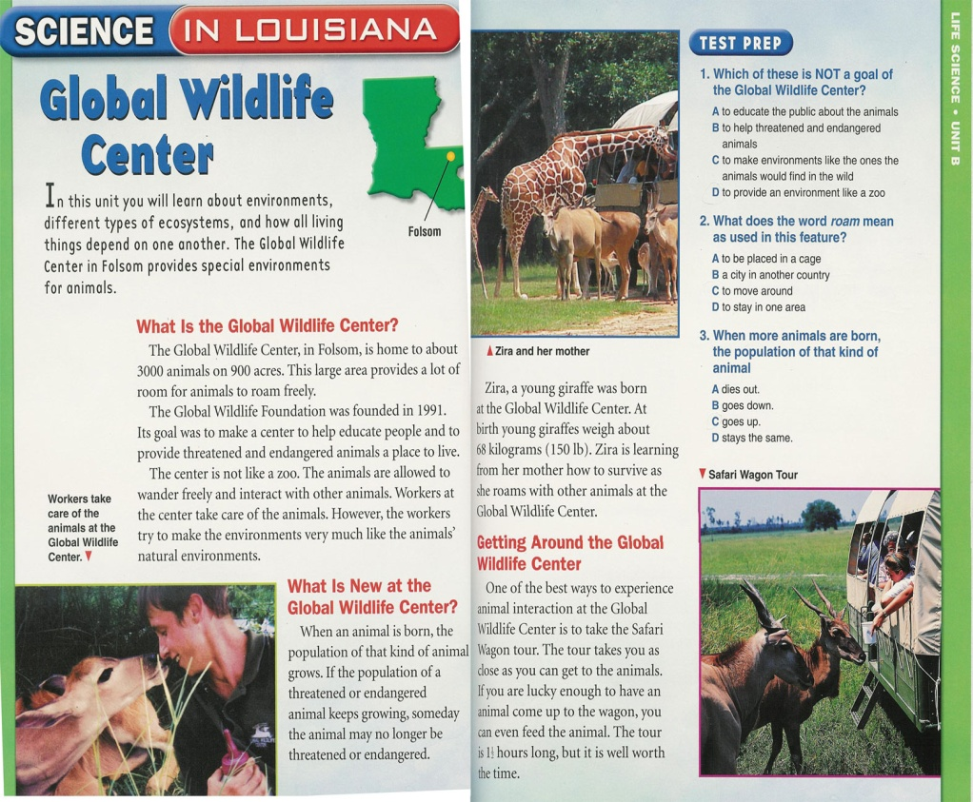
WHAT ARE TEXT FEATURES?
While you are reading, do you notice titles, charts, photos, captions, headlines, bold or italicized print? THOSE ARE TEXT FEATURES!
If you learn how to identify text features and use them prior to reading a text, you will improve your comprehension.
TYPES OF INFORMATIONAL TEXT FEATURES
Print Features
Organizational Aids
Graphic Aids
Illustrations
This science textbook contains of variety of text features to help the reader understand the content.

Slide 2
PRINT FEATURES
Guide readers through the patterns of organization
Feature Helps the Reader…
Table of Contents identify key topics in the book and the order they are presented in
Index see everything in the text listed alphabetically with page numbers
Glossary define words contained in the text
Preface set a purpose for reading, get an overview of the content
Pronunciation Guide say the words
Appendix by offering additional information

Slide 3
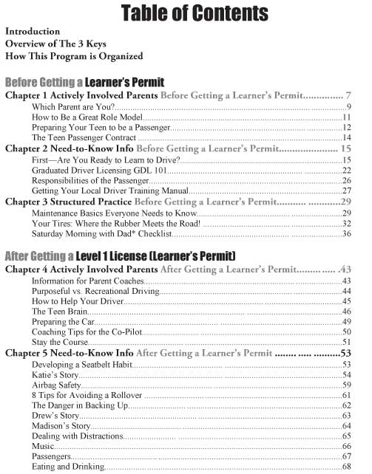

Slide 4
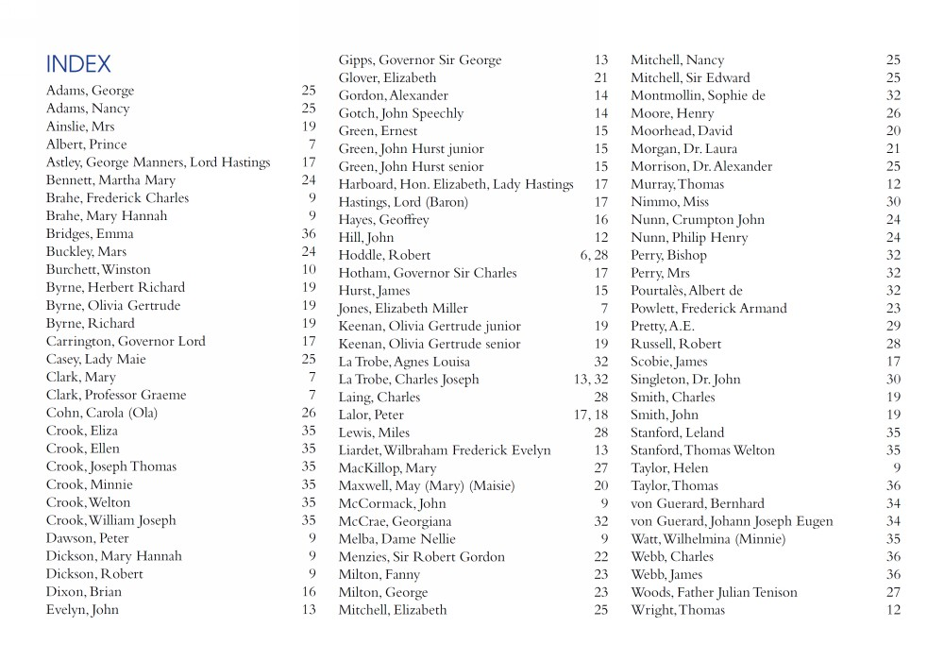

Slide 5
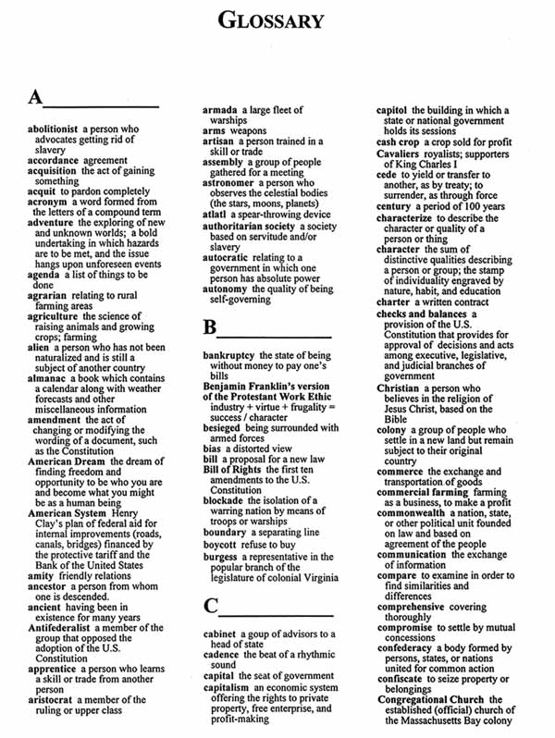

Slide 6
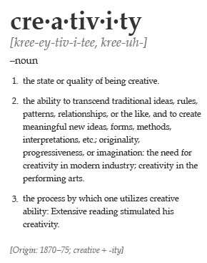

Slide 7
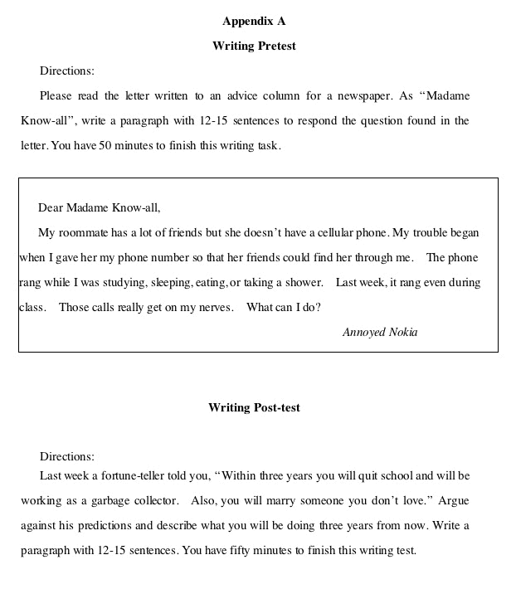

Slide 8
GRAPHIC AIDS
Represent information in some specific way
Feature Helps the Reader…
Bold Print by signaling the word is important and/or found in the glossary
Italics understand the word is important
Bullets emphasize key points/ concepts
Titles locate different categories in the text
Headings identify topics throughout the book as they skim and scan
Subheadings navigate through sections of text
Diagram with Labeled Parts identify a picture and/or its parts
Captions understand pictures and photographs

Slide 9
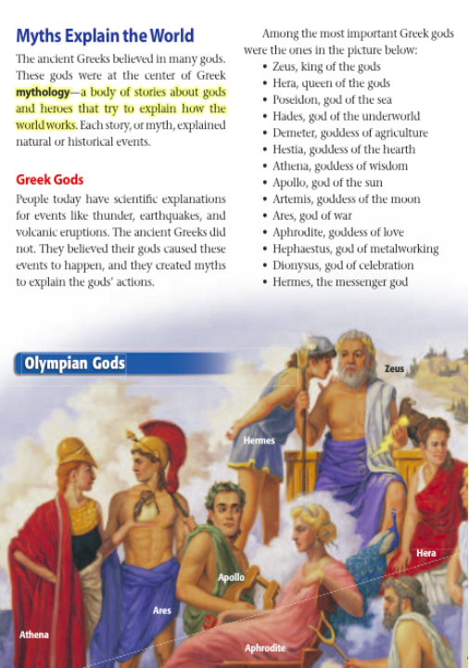

Slide 10
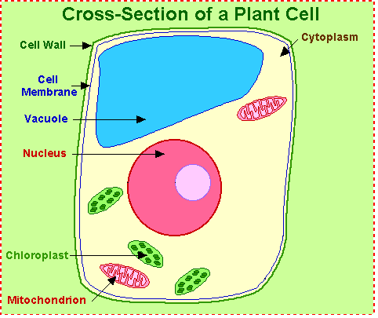

Slide 11
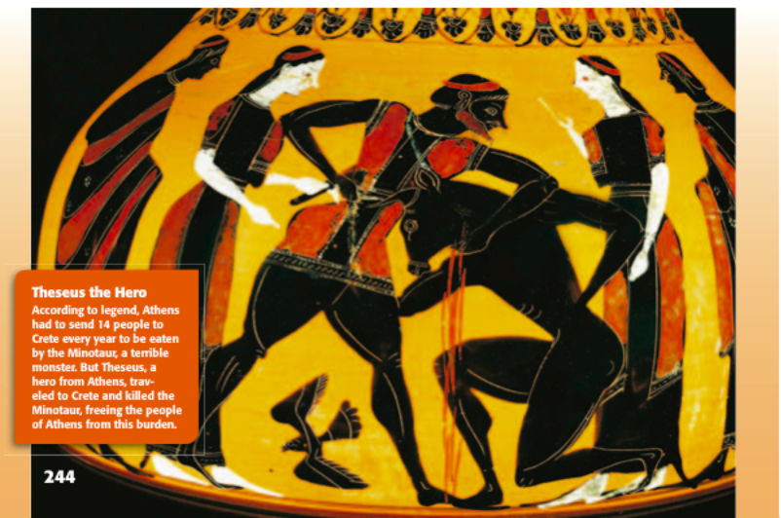

Slide 12
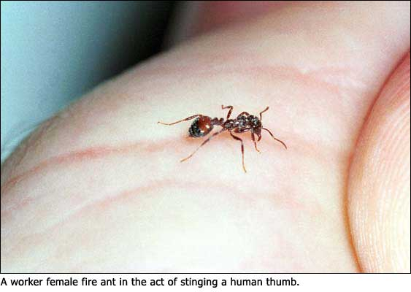
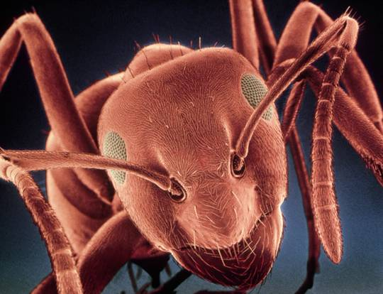
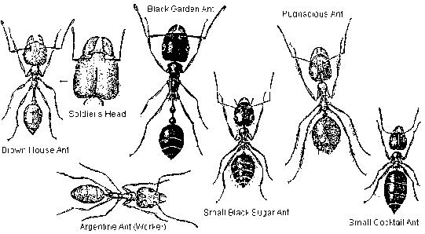
ILLUSTRATIONS
Expand the meaning of the text
Feature Helps the Reader…
Photographs understand exactly what something looks like
Drawings understand what something could or might have looked like
Magnification see details in something
Drawings of different types of ants
A magnified ant head.

Slide 13
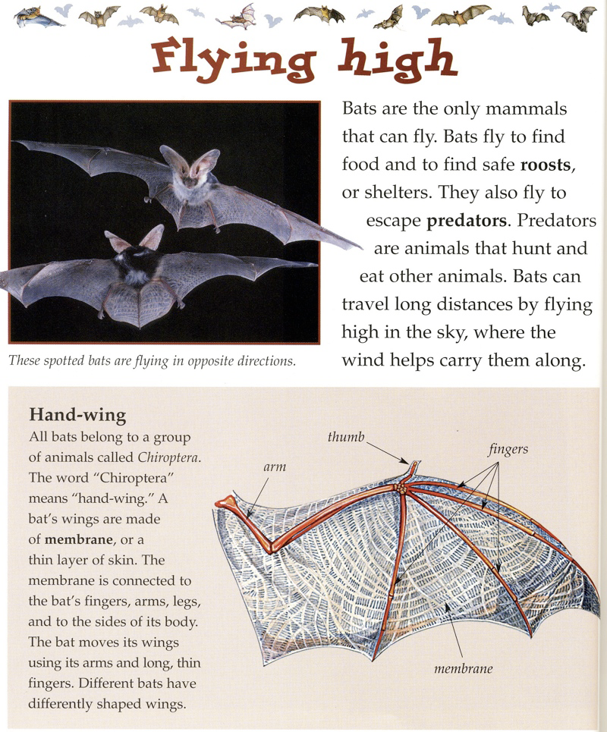
NOW THAT YOU KNOW ABOUT TEXT FEATURES
Read the article, Flying High. Your goal is to identify as many informational text features as possible. Write the types you find on the graphic organizer provided.

Slide 15
ANSWERS
THE TEXT FEATURES YOU SHOULD HAVE FOUND:
Title (Flying High)
Heading (Hand-wing)
Labels
A Caption
A Photograph
A Diagram
Bold Print
Italics
NEXT TIME YOU READ
Pay attention to the text features as you read. See if you can put them to use to increase your comprehension and maybe you will even finish your assignment in less time!

