Slide 1
Fiction
Notes 2
RL.8.4 – RL.8.6 – RL.8.9
:: Suspense :: Humor :: Irony :: :: Mood :: Tone ::

Slide 2
The Purpose of Suspense
Suspense maintains reader engagement.
Suspense fiction keeps the reader guessing what will happen next.
Suspense presents the reader with many twists and turns.

Slide 3
Using Suspense
Authors typically create suspense in four ways:
The reader possesses information that the characters do not know.
Information is hidden from both the characters and the reader, yet clues are divulged throughout the novel.
Authors create a question at the novel’s beginning and only answer it at the novel’s close.
Authors create harrowing obstacles for the protagonist to overcome.

Slide 4
The Role of Humor
Humor often serves one of three roles in texts:
Humor can address societal problems or issues.
Humor can relieve tension during the plot.
Humor can create a light-hearted situation.

Slide 5
Types of Humor
Hyperbole –extreme exaggeration.
  For example, a character could say “I’m so hungry I could eat a horse.”
Irony –the opposite of the expected.
  Verbal Irony
  Situational Irony
  Dramatic Irony
Jokes –spoken with the intent of making the audience laugh.
Sarcasm – a sharp, often cutting statement.
  For example, if one character makes a silly remark, another character could reply “Well DUH. Everyone knows that!”

Slide 6
What is Irony?
It’s funny!
It’s unexpected.
It sometimes creates suspense.
It’s like Cupid never falling in love.

Slide 7
The Big Picture
Irony
Verbal
Irony
Situational
Irony
Dramatic
Irony

Slide 8
Three Types of Irony
1. Verbal irony is when an author says one thing and means something else.
2. Dramatic irony is when an audience perceives something that a character in the literature does not know.
3. Situational irony is a difference between what is expected and what happens

Slide 9
Verbal Irony
The simplest kind of irony.
You use it everyday when you say one thing and really mean another.
It is often similar to a sarcastic response.
Examples:
  When you appear to be sick and someone asks you if you’re okay. You say “Of course!” But in the meantime you are vomiting and fainting.
  Your boyfriend shows up in ripped up jeans and a stained t-shirt. With a smirk, you say, "Oh! I see you dressed up for our date. We must be going to a posh restaurant."
http://www.youtube.com/watch?v=PUadZ6ALU0M

Slide 10
Situational Irony
Occurs when a situation turns out to be the opposite of what you thought it would be.
Examples:
  The teacher’s daughter is a High School drop out.
  The mayor’s wife gets caught stealing.
  The chef won’t eat his/her own cooking.
  The barber always needs a hair cut himself.
  You break a date with your girl friend so you can go to the ball game with the guys. When you go to the concession stand, you run into your date who is with another guy.
  You stay up all night studying for a test. When you go to class, you discover the test is not until the next day.
http://www.youtube.com/watch?v=Nm-1xvWibt0

Slide 11
Dramatic Irony
Occurs when the audience knows something that the characters in the story, on the screen, or on the stage do not know. It’s like the audience is more aware of what’s going on than the people in the production.
This is used to engage the audience and keep them actively involved in the storyline.

Slide 12
Dramatic Irony continued…
In all of the Friday the 13th movies, we know Jason is in the woods. The characters do not. When they go out into the woods we are afraid for them because we know that they are in danger. We scream for them to run, we get excited when they fall, we cringe when we know that Jason is right behind the tree.
When watching a talk show, the audience knows why a person has been brought on the show. However, the person sitting in a chair does not know that he is going to be reunited with a former lover. This adds to the suspense and humor of the show.
http://www.youtube.com/watch?v=EP-1kt92vqY

Slide 13
Tone
Tone is the AUTHOR’S attitude towards the audience, the subject, or the character
You can recognize the tone/attitude by the language/word choices the author uses. His language will reveal his perspective/opinion (that is, whether it is positive/negative) about the subject.

Slide 14
Written Tone
Verbal tone is easier to detect Teacher Student
Big Brother Little Brother
Written Tone can be more difficult. When in doubt, readers must examine the context of the story itself.
Tone must be inferred through the use of descriptive words.

Slide 15
DESCRIBING TONE
Adjectives are used to describe tone
Consider some words that describe tone.
  Sarcastic, sincere, embarrassed, proud or frightened
The key to choosing the correct tone is to carefully consider the author’s word choice.

Slide 16
TONE Adjectives
Bitter
Serious
Witty
Playful
Tender
Sympathetic
Haunting
Mysterious
Suspenseful
Tasteful/distasteful
Nonchalant
Angry
Attached/Detached
Innocent
Poignant
Compassionate
Humorous
Gory

Slide 17
MOOD
Mood is the overall atmosphere of a piece of literature
The mood is created by the setting, the characters, and their actions

Slide 18
DESCRIBING MOOD
Adjectives describe Mood
Remember that you are NOT describing the way the person feels
Like tone, mood words can be either positive or negative
Examples: relaxed, cozy, romantic, gloomy, frightening, somber

Slide 19
Mood
Identifying the mood of a piece of writing will depend on the number of descriptive words you know to answer the question: How did this paragraph, this passage, this story make the character or make you feel?

Slide 20
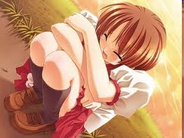
What is the mood of this picture?

Slide 21


Slide 22
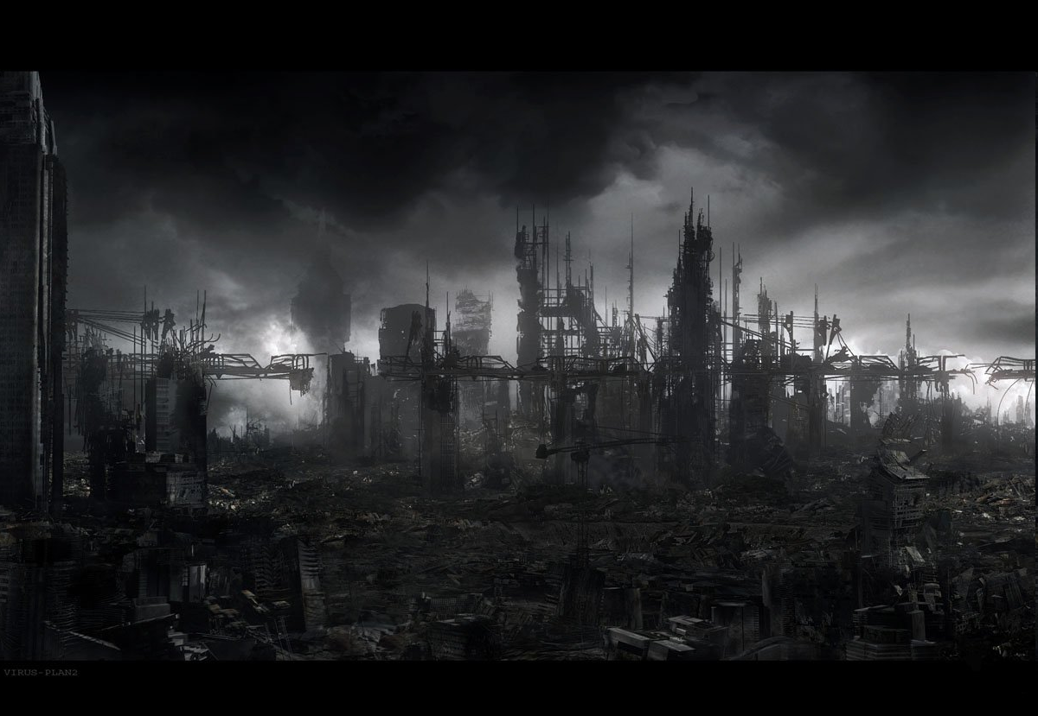

Slide 23
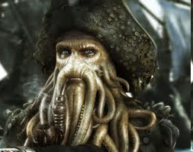

Slide 24
DIFFERENCE BETWEEN TONE AND MOOD
Tone = Person + Attitude
Mood = Environment

Slide 25
Connotation vs. Denotation
Denotation is the dictionary definition of a term. It is the literal meaning of a word, what a term means.
Connotation is the emotions, thoughts, images, and associations attached to a word. It is what a term implies. Terms can have positive, negative, or even neutral connotations. It all depends on the context, how and where the word is used.

Slide 26
FINISH VS. TERMINATE
Both terms denote bringing something to an end
“To finish” can have positive connotations: a sense of completion and accomplishment (finishing school, crossing the finish line); it can also have neutral connotations (I finished folding the laundry); and it can sometimes have negative connotations: a sense of an eternal end (You’re finished in this town! You’ll never work here again!)
“To terminate” really only has negative connotations: termination implies an eternal end, but does not imply completion or accomplishment. No one ever races to cross the “termination line.”

Slide 27
Analogy
Comparing two objects, events, actions, people, etc. that are similar one or more ways
Makes unfamiliar topic (uncommon experience) familiar by comparing it to well-known, common, familiar topics/experiences
Example: from Shakespeare’s “Sonnet #130” “black wires grow on her head” – Her hair is thick and stiff like wires
Readers don’t know what “her” hair looks like (unfamiliar), Shakespeare compares it to wires (familiar) which helps the reader understand/see the image

