Slide 1
Holocaust Infographic Project

Slide 2
What is an Infographic?
Infographics are a visual representation of data.
They use pictures and charts to present information to an audience.

Slide 3
Your Assignment:
Create an infographic representing information from a topic relating to The Holocaust or WWII.
Be sure that you answer the following questions:
Does it have a main idea or thesis?
Does the data support the main idea?
Do the graphics enhance and support the data?
Does the layout and design have a purpose; did you organize the graphics and text to communicate your ideas effectively?

Slide 4
Your infographic must contain:
A title
An overview of your topic
At least 1 graph/chart
At least 3 pictures
5 facts/statistics about your topic
It must be visually appealing
You must use words to promote an understanding of your topic (usually, for every photo or image you have - you should have a concise statement to help your audience understand it)
Do not plagiarize. It would be easy for you to find an infographic online and copy everything it says - do not do this! I will be checking this and I will find out. Not only will you get a zero on the project but we will have to have a serious conversation with Frontier’s administration

Slide 5
Websites
http://piktochart.com/
https://venngage.com/
https://www.canva.com/create/infographics/
http://www.easel.ly/

Slide 8
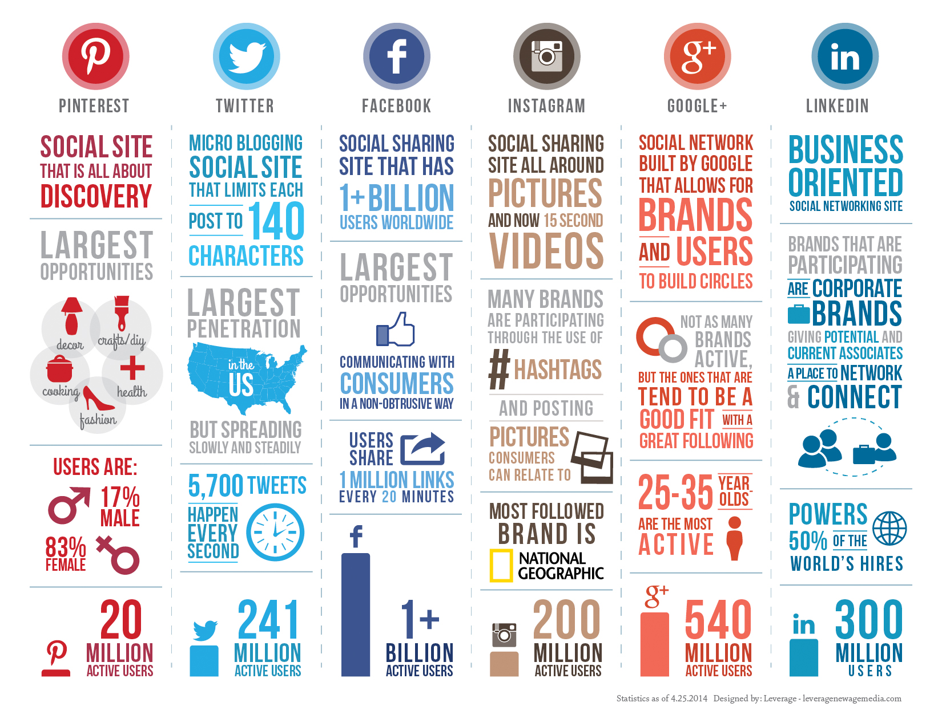

Slide 9
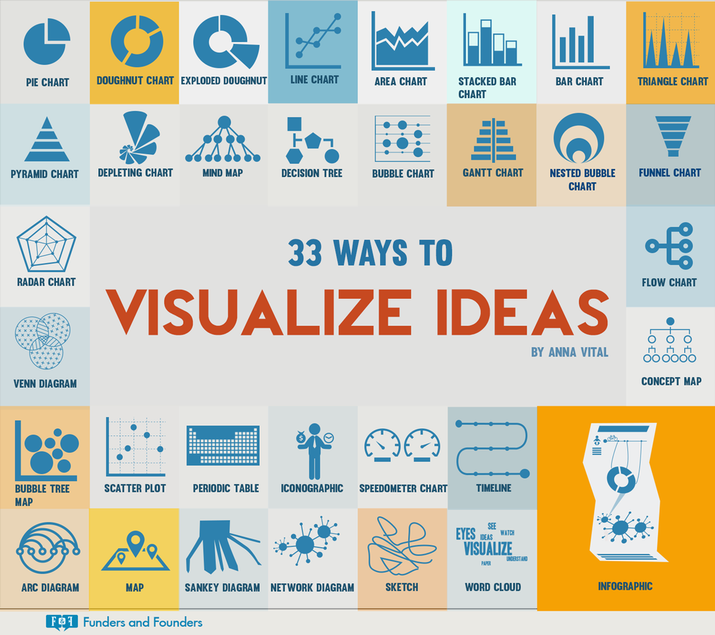

Slide 10
Topic List
Hitler
Hitler Youth
Concentration/Death Camps
Ghettos
Resistance
War Crime Trials
Nuremburg Laws
SS
Oskar Schindler
Dwight Eisenhower
Winston Churchill
Nazi Propaganda
Underground
Kindertransport
Hiroshima/Nagasaki Bombing
Pearl Harbor

Slide 11
Websites
www.ushmm.org/
www.jewishvirtuallibrary.org/
remember.org
http://fcit.usf.edu

