Slide 1
MLA Style PowerPoint Presentations
How to acknowledge your sources according to MLA Style in an in-class presentation.

Slide 2
Plagiarism and Your Presentation
Plagiarism can occur on any assignment including an in-class presentation.
Treat your PowerPoint slide like you would any research paper. Provide citations and a bibliography for ANY outside sources, including:
  Direct quotations
  Paraphrased words and ideas
  Tables and graphs
  Images
  Video and audio files

Slide 3
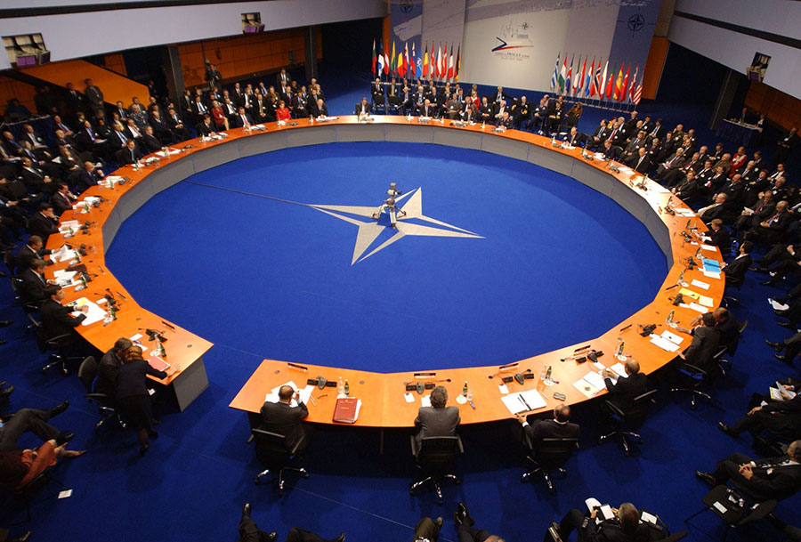
What is NATO?
Beatrice Brown
Mr. Isham
English 8
November 13, 2016
Title Slide: Include the same information you would on the first page of a MLA Style paper.
Fig. 1. NATO Summit (Frost).
Web Image: Include a figure note describing the image and a parenthetical citation.

Slide 4
What is NATO?
“Acronym for North Atlantic Treaty Organization. An organization established by a treaty signed in 1949 by Belgium, Canada, Denmark, France, Iceland, Italy, Luxembourg, The Netherlands, Norway, Portugal, the UK, and the USA; Greece and Turkey acceded in 1952, West Germany in 1955, and Spain in 1982” (“NATO”).
Currently 28 member states (North Atlantic Treaty Organization).
Citations: For a quotation.
Citations: For a paraphrase.

Slide 5

NATO Flag
Note: Adjust figure and table numbers as you would in a MLA Style paper.
Fig. 2. NATO Flag (Mysid).

Slide 6
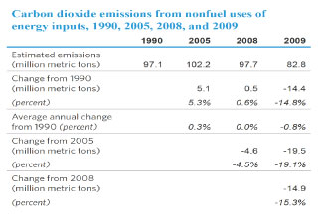
NATO and Pollution
Table 1. United States Emissions Non Fuel Sources
Tables: Provide complete citation in source note.
Source: United Nations Statistics Division. “Carbon Dioxide Emissions Non fuel sources (CDIAC).” Millennium Development Goals Database. UNData.org. United Nations, 29 Aug. 2011. Web. 1 Feb. 2012

Slide 7
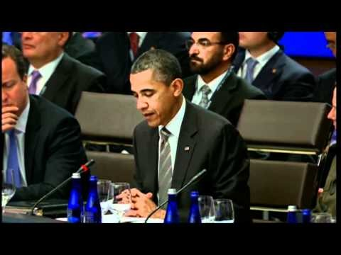
NATO Summit Meeting
Video: Provide complete citation in source note.
Source: “NATO Summit Chicago- President Obama's Welcoming Remarks at the Meeting on Afghanistan.” YouTube, uploaded by natochannel.tv, 21 May, 2012 , www.youtube.com/watch?v=pnkIoNSwgnE . Web. 12 Sept. 2012.

Slide 8
Works Cited
Frost, Patrick. “Nato-Summit-300x203” Image. Great Power Politics. Patrick Frost, 24 Dec. 2008. Web. 2 Feb. 2012.
Mysid, “File:NATO flag.svg.” Image. Wikipedia.org. Wikipedia Foundation, 4 Dec. 2010. Web. 2 Feb. 2012.
“NATO.” The Crystal Reference Encyclopedia. West Chiltington: Crystal Semantics, 2005. Credo Reference. Web. 2 Feb. 2012.
“NATO Summit Chicago- President Obama's Welcoming Remarks at the Meeting on Afghanistan.” YouTube, uploaded by natochannel.tv, 21 May, 2012 , www.youtube.com/watch?v=pnkIoNSwgnE . Web. 12 Sept. 2012.
North Atlantic Treaty Organization. “NATO Member Countries.” NATO.int. North Atlantic Treaty Organization, 10 Match 2009. Web. 2 Feb. 2012.
United Nations Statistics Division. “Carbon Dioxide Emissions from Non-fuel Sources (CDIAC).” Millennium Development Goals Database. UNData.org. United Nations, 29 Aug. 2011. Web. 2 Feb. 2012.

Slide 9
Web Source
Editor, author, or compiler name (if available). “Article Name.” Name of Site. Version number. Name of institution/ organization affiliated with the site (sponsor or publisher). Date of last update. Medium of publication. Date of access.

