Slide 1
Poetry Terms

Slide 2
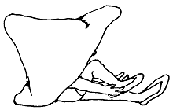
Form and Structure
Poems are written in lines
Lines are grouped together to form stanzas.
Tryin' On Clothes
I tried on the farmer's hat,
Didn't fit...
A little too small -- just a bit
Too floppy.
Couldn't get used to it,
Took it off.
I tried on the dancer's shoes,
A little too loose.
Not the kind you could use
for walkin'.
Didn't feel right in 'em,
Kicked 'em off.
I tried on the summer sun,
Felt good.
Nice and warm -- knew it would.
Tried the grass beneath bare feet,
Felt neat.
Finally, finally felt well dressed,
Nature's clothes fit me best.
-Shel Silverstein
Stanza

Slide 3
The way the poems lines and words are arranged on a page is it’s
form.
Ballad: tells a story; sung or recited aloud
Epic: long narrative poem about a hero; ideals reflect a society
Ode: lyric poem; addresses serious themes
Sonnet: formal structure; 14 lines, specific rhyme scheme and meter
Free Verse: no regular pattern; any subject

Slide 4
Sound
Poets use sound devices to reinforce the meaning of a poem.

Slide 5
Rhyme:
The repetition of sounds at the ends of words: Shell, Well, Tell.
Internal Rhyme:
The use of rhyming words within a line.
End Rhyme:
The use of rhymes at the end of a line.
There's a Polar Bear
In our Frigidaire--
He likes it 'cause it's cold in there.
With his seat in the meat
And his face in the fish
And his big hairy paws
In the buttery dish
______ Rhyme?
______ Rhyme?
-Shel Silverstein

Slide 6
Rhyme Scheme:
Humpty-Dumpty sat on a wall,
Humpty-Dumpty had a great fall;
All the King’s horses and all the King’s men
Couldn’t put Humpty-Dumpty together again.
A
A
B
B
The pattern of end rhymes in a poem.
Marked with letters

Slide 7
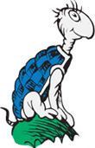
Rhythm:
The pattern of sound created by stressed and unstressed syllables in a line of poetry
Stressed Syllables are the ones read with emphasis
Unstressed Syllables are the ones read with no emphasis
I’m Yertle the Turtle!
Oh, marvelous me!
For I am the ruler
of all that I see!
Your Majesty. Please…
I don’t like to complain.
But down here below,
we are feeling great pain.

Slide 8
Meter
I HAD a LIttle DOG,
It's FUR was SOFT as WOOL;
It FOLLowed ME aROUND,
My HOME, my STREET, my SCHOOL
ba BUM ba BUM ba BUM
A regular pattern of stressed and unstressed syllables.

Slide 9
Repetition
Sounds, words, phrases, or lines that are stated or used more than once in a poem.
I'm being swallered by a Boa Constrictor
a Boa Constrictor, a Boa Constrictor
I'm being swallered by a Boa Constrictor
and I don't - like snakes - one bit!
Oh no, he swallered my toe.
Oh gee, he swallered my knee.
Oh fiddle, he swallered my middle.
Oh what a pest, he swallered my chest.
Oh heck, he swallered my neck.
Oh, dread, he swallered my - (BURP)

Slide 10
Alliteration
The repetition of consonant sounds at the beginning of words
She Sells SeaShells by the SeaShore

Slide 11

Assonance
The repetition of vowel sounds to create internal rhyming within phrases or sentences.
On a proud round cloud in white high night
— E. E. Cummings

Slide 12
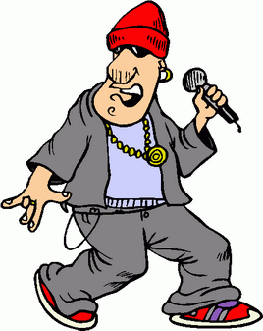
Consonance
"Rap rejects my tape deck, ejects projectile
Whether Jew or gentile, I rank top percentile
Many styles, More powerful than gamma rays
My grammar pays, like Carlos Santana plays”
-'Zealots 'by Fugees
The repetition of consonant sounds to create internal rhyming within phrases or sentences.

Slide 13
Imagery
Words and phrases that appeal to the five senses; helps the reader draw a picture in their mind.

Slide 14
Figurative Language
Conveys a meaning beyond the ordinary literal meaning

Slide 15
Simile:
Comparison of two things using like or as
Life is like a journey
Metaphor:
Comparison of two things without using like or as
Life is a journey

Slide 16
Personification
When a poet describes an animal or object as if it were human or had human qualities
The stars danced playfully in the moonlit sky.

Slide 17
Onomatopoeia
The use of words that imitate the sounds associated with the objects or actions they refer to.
water plops into pond
splish-splash downhill
warbling magpies in tree
trilling, melodic thrill
whoosh, passing breeze
flags flutter and flap
frog croaks, bird whistles
babbling bubbles from tap
-Lee Emmett

Slide 18
Hyperbole
I’m so hungry I could eat a cow!!!
An exaggeration that is so dramatic that no one would believe the statement is true.

Slide 19
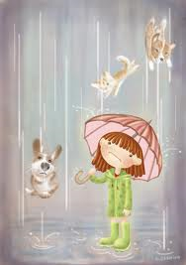
Idiom
It’s raining cats and dogs!
a word or phrase that is not meant to be taken literally

Slide 20
Symbol
A person, a place, an object, or an action that stands for something beyond itself.

Slide 21
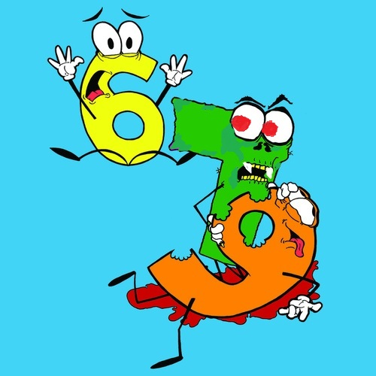
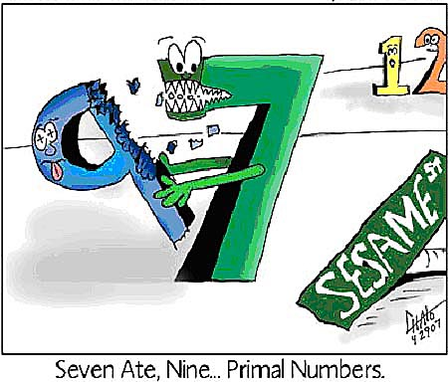
PUN
Seven, Six and Nine
Seven, Six and Nine
all sat down to dine.
Now Six is scared of Seven
because Seven ate Nine.
The use of a word or words that either have multiple meanings or sound like other words, the result of which is humorous.

