Slide 1
Research Skills
Citing Sources

Slide 2
Facts, Opinions, & Bias
Facts can be proven to be true
Opinions are judgments that people make based on their beliefs
Bias is an unfair “slant” that a writer gives to a topic
  Try not to use bias in your informational writing

Slide 3

Resource
Something you can use to help you write a research paper

Slide 4
Primary Source
Source material that comes directly from the time or person you are researching
Primary Sources are more valuable because they are more accurate
Examples of Primary Sources:
  Diaries
  Autobiographies
  Letters

Slide 5
Secondary Source
Secondary sources – discusses information originally presented elsewhere
Examples of Secondary Sources:
  Reference books (encyclopedias, dictionaries, atlases)
  Periodicals/Magazines/Newspapers
  Textbooks
  Biographies
  Web sites
  Videos

Slide 6
Reliable Source
Print sources -
  Secondary sources should be newly printed (5-10 years or less)
  Who wrote the book/article?
  Why did they write the book/article?
Online Sources –
  What person or organization made and maintains the website?
  What is the purpose of the site?
  When was the site updated?

Slide 7

Plagiarism
To steal and pass off (the ideas or words of another) as one's own
To use (another's production) without crediting the source
To present as new and original an idea or product derived from an existing source
In other words, plagiarism is an act of fraud. It involves both stealing someone else's work and lying about it afterward.

Slide 8
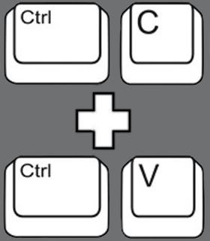
All of the following are considered plagiarism:
Turning in someone else's work as your own
Copying words or ideas from someone else without giving credit
Failing to put a quotation in quotation marks
Giving incorrect information about the source of a quotation
Changing words but copying the sentence structure of a source without giving credit
Copying so many words or ideas from a source that it makes up the majority of your work, whether you give credit or not

Slide 9
Citing Sources
Works Cited - the last page of your informational piece

Slide 10
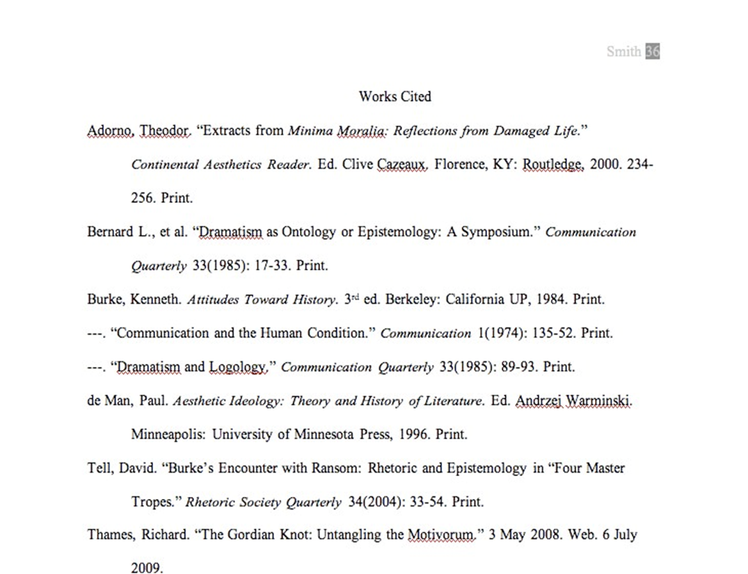

Slide 11
Book
Lastname, Firstname. Title of Book. Place of Publication: Publisher, Year of Publication. Medium of Publication.
Web Source
Editor, author, or compiler name (if available). “Article Name.” Name of Site. Version number. Name of institution/ organization affiliated with the site (sponsor or publisher). Date of last update. Medium of publication. Date of access.
Article in a Magazine Format
Author(s). “Title of Article.” Title of Periodical Day Month Year: pages. Medium of publication.

Slide 12
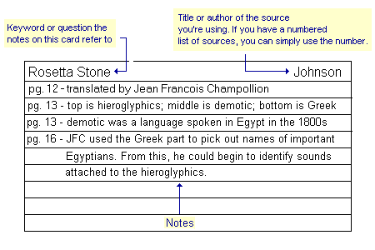
All citation information should be on the back of your card.

Slide 13
In Text Citations
MLA uses parenthetical citations
Parenthetical citations depend on the medium
(e.g. Print, Web, DVD)
Parenthetical citations also depend on the source’s
entry on the Works Cited page
Signal word in the text is the first thing in the
corresponding entry on the Works Cited page

Slide 14
In-text Example:
Wordsworth stated that Romantic poetry was marked by a “spontaneous overflow of powerful feelings” (263).
Romantic poetry is characterized by the “spontaneous overflow of powerful feelings” (Wordsworth 263). Wordsworth extensively explored the role of emotion in the creative process (263).
Corresponding Works Cited Entry:
Wordsworth, William. Lyrical Ballads. London: Oxford
UP, 1967. Print.

Slide 15
Sources from the Internet
In-text Example:
One online film critic stated that Fitzcarraldo is “...a beautiful and terrifying critique of obsession and colonialism” (Garcia, “Herzog: a Life”).
Corresponding Works Cited Entry:
Garcia, Elizabeth. “Herzog: a Life.“ Online Film Critics Corner. The Film School of New Hampshire, 2 May 2002. Web. 8 Jan. 2009.

Slide 16
Long Quotes
In-text Example:
Nelly Dean treats Heathcliff poorly and dehumanizes him throughout her narration:
They entirely refused to have it in bed with them, or even in their room, and I had no more sense, so, I put it on the landing of the stairs, hoping it would be gone on the morrow. By chance, or else attracted by hearing his voice, it crept to Mr. Earnshaw's door, and there he found it on quitting his chamber. Inquiries were made as to how it got there; I was obliged to confess, and in recompense for my cowardice and inhumanity was sent out of the house. (Bronte 78)

Slide 17
MLA Guidelines
Type on white 8.5“ x 11“ paper
Double-space everything
Use 12 pt. Times New Roman font (or similar font)
Leave only one space after punctuation
Set all margins to 1 inch on all sides
Indent the first line of paragraphs one half-inch
Header with page numbers in the upper right corner
Use italics for titles

Slide 18
MLA Guidelines
No title page
Double space everything
In the upper left corner of the 1st page, list your
name, your instructor's name, the course, and date
Center the paper title (use standard caps but no underlining, italics, quote, or bold)
Create a header in the upper right corner at half inch from the top and one inch from the right of the page (include your last name and page number)

Slide 19
