Slide 1
Bellwork: How did you personally identify with Ben Kamm while reading Fighting Hitler? Use specific examples from the text.

Slide 2
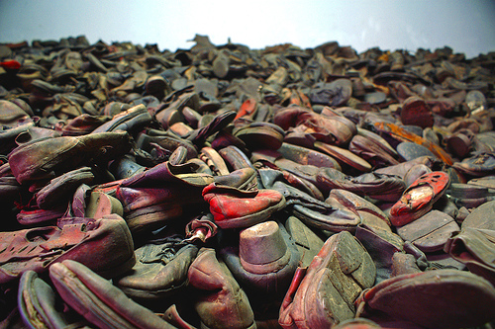
http://www.un.org/en/holocaustremembrance/educational%20Footprint.shtml

Slide 4
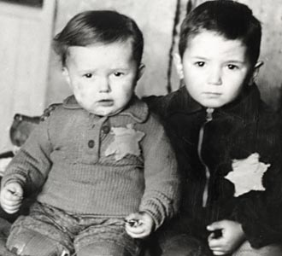
1. What happened to the people whose shoes were piled up in the wagon? Explain what details in the poem led to your conclusion.
2. In the second stanza, the speaker compares the wagon of shoes with a wedding, saying the shoes are like people in a dance. What other activities does the speaker imagine the shoes participating in?

Slide 5
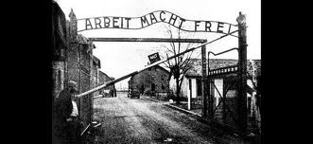
3. Why do you think the speaker describes the shoes as “throbbing” in the first stanza?
4. Why do you think Sutzkever chose to use so many words and images of life and celebration?
5.List the questions that the speaker asks in the poem.

Slide 6
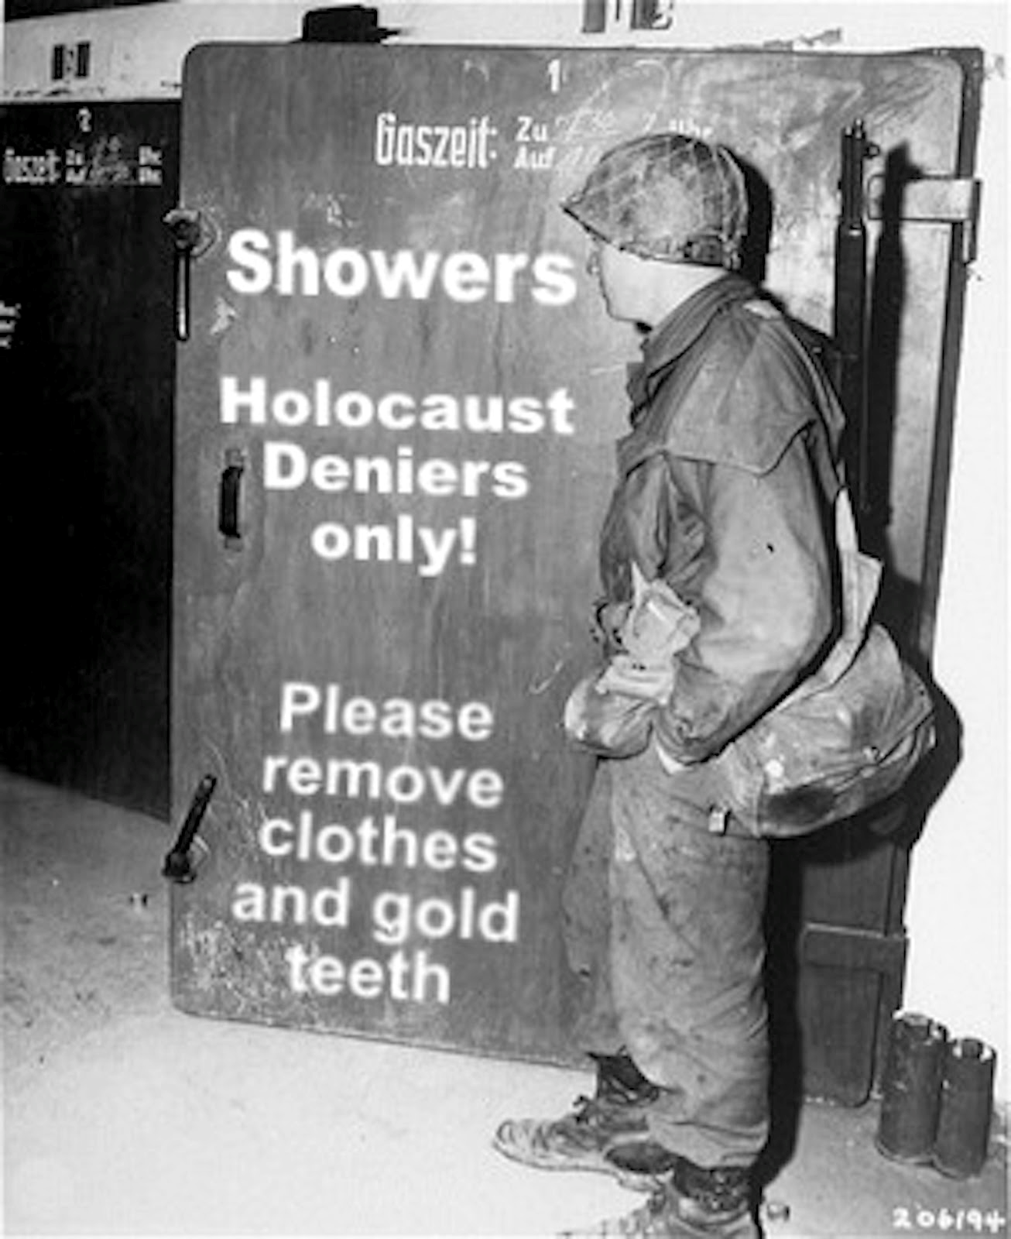
6. How do these questions affect the reader? What mood do they create?
7. What can you infer happened to the speaker’s mother from the lines, “Mid clogs and children’s sandals,/My Mama’s shoes I see!”

Slide 7
8. In the refrain, the speaker says, “The shoes tap with no malice.” Why do you think he described the shoes this way?
9. Referring to his experiences during the Holocaust, Sutzkever said, “As long as I was writing, I would have a weapon against death.” What do you think he meant by this?

Slide 8
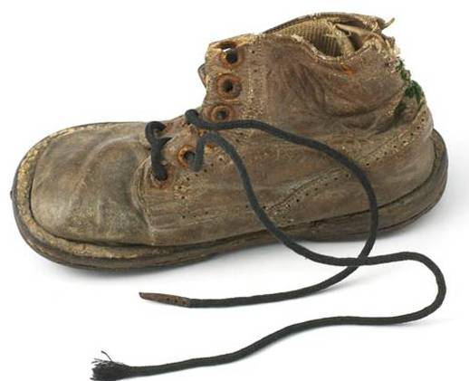
Exit Slip
Compare each: Anne Frank, Gerda Weisemann, Fighting Hitler, A Wagon of Shoes, the video, and discussion; which impacted you the most, and which text structure did you like the most/least? Write 1 full page.

